Slide 1
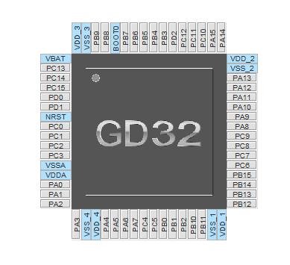
M510 with MT6816 encoder
Battery switch
DC/DC switch
PAS 1 (white)
PAS 2 (pink)
Encoder Z
PAS (green)
CLK
Brake
LED
DIO
CAN Tx
OSCIn
CAN Rx
OSC0ut
Timer0 CH2
Timer0 CH1
Timer0 CH0
ADC Battery voltage
Encoder B
Encoder A
Timer0 CH2 ON
ADC Battery Current
Timer0 CH1 ON
Encoder PWM
Timer0 CH0 ON
ADC PhaseA Current
Timer0 BKIN
Speed
ADC Throttle
ADC PhaseB Current
ADC PhaseC Current
ADC Torque (brown)
ADC Battery voltage with offset

Slide 2
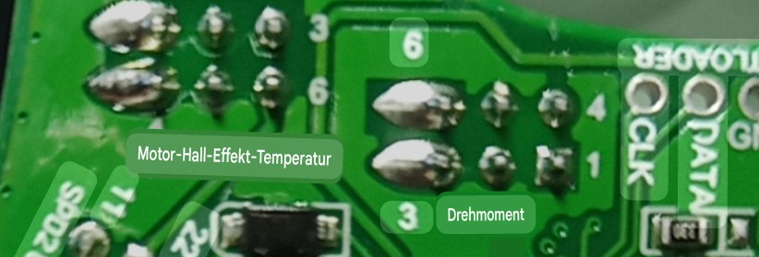
PA15 speed/direction
PA7 torque
GND
+5V
PC10 PAS1
PC11 PAS2

